Slide 1
網路爬蟲技術實作研習- 抓取旅遊資訊為例
David Chiu
2016/04/10

Slide 2

關於我
大數軟體有限公司創辦人
前趨勢科技工程師
ywchiu.com
粉絲頁https://www.facebook.com/largitdata
Machine Learning With R Cookbook
https://www.packtpub.com/big-data-and-business-intelligence/machine-learning-r-cookbook

Slide 3
課程資料
所有課程補充資料、投影片皆位於
https://github.com/ywchiu/pytravel

Slide 4
課前預備

Slide 5
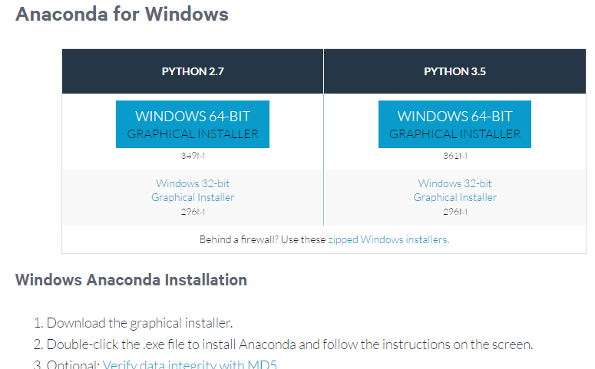
安裝Anaconda
選擇Python 2.7 版
https://www.continuum.io/downloads

Slide 6
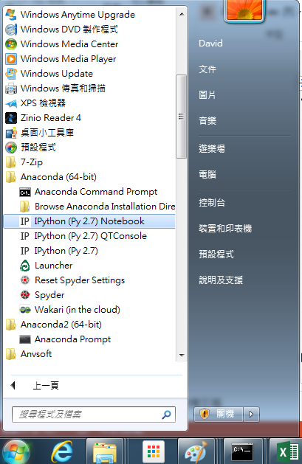
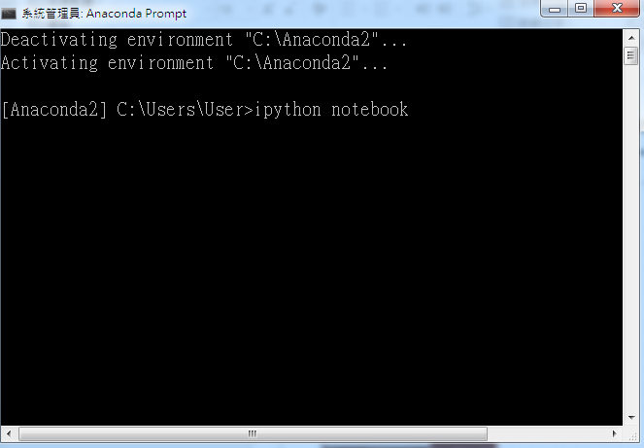
使用 Jupyter (Ipython Notebook)
點選Ipython Notebook
或在Anaconda Prompt 下打入
Ipython notebook

Slide 7
資料爬取

Slide 8

數據分析很重要
但關鍵掌握在使用的數據
必須借重ETL (Extract, Transformation, Loading)程序自動化蒐集資訊

Slide 9
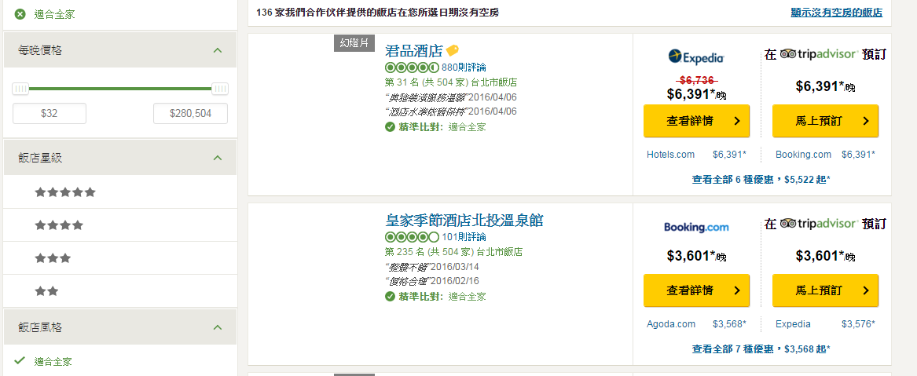

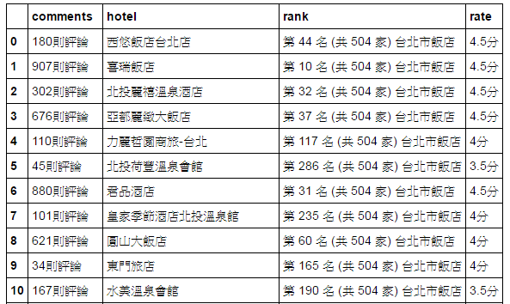
將非結構化數據轉變為結構化數據
透由簡單的SQL語句
從結構化資料中
達到簡單的分析目的

Slide 10
爬蟲是怎麼運作的
請求 Request
資料中心
Data Center
網頁
網頁連結器
Web Connector
回應 Response
資料剖析
Data Parser

Slide 11
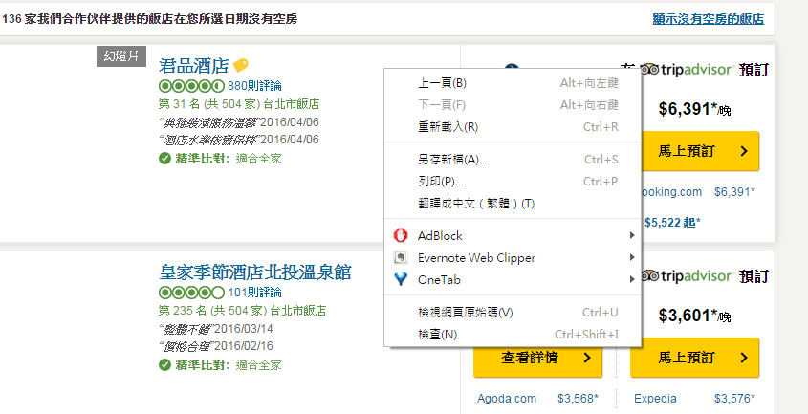
使用開發人員工具
於網頁上點選右鍵 -> 檢查
點選檢查

Slide 12
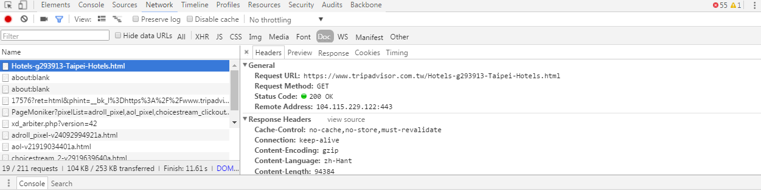
觀察HTTP 請求與返回內容
1. 點選Network
3. 點選連結
2. 點選Doc

Slide 13

什麼是GET?
GET
內容寫在上頭
https://www.tripadvisor.com.tw/Hotels-g293913-Taipei-Hotels.html

Slide 14
Python 抓取網頁的主流套件
Urllib2
提供獲取URLs(Uniform Resource Locators)的函式及類別
Requests
改善Urllib2 的缺點，讓使用者以最簡單的方式獲取網路資源
使用REST 操作，可以調用GET,POST, PUT, DELETE

Slide 15
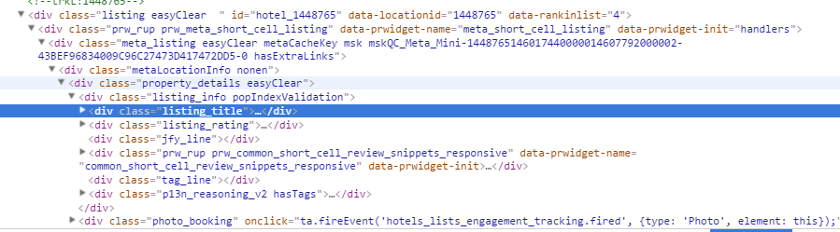
使用GET 抓取頁面資訊
import requests
res = requests.get('https://www.tripadvisor.com.tw/Hotels-g293913-Taipei-Hotels.html')
print res.text
網頁原始碼

Slide 16
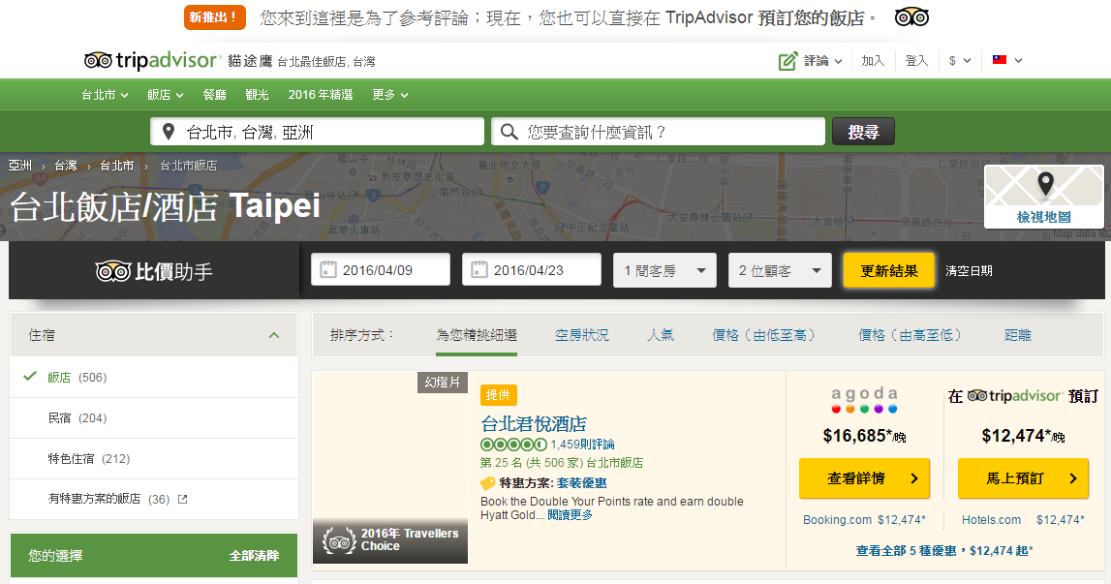
抓取不同日期區間資料

Slide 17
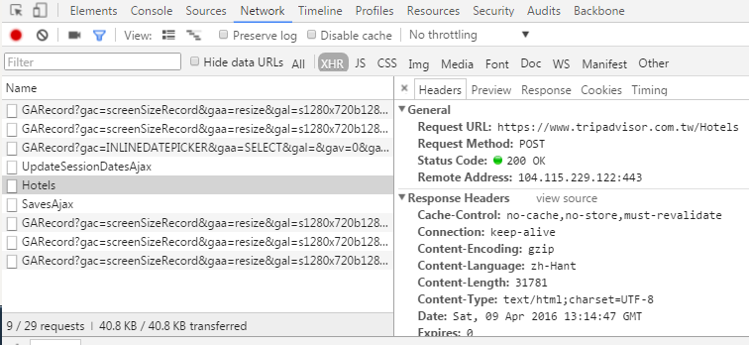
找尋更新資訊
1. 點選Network
2. 點選XHR
3. 點選連結

Slide 18
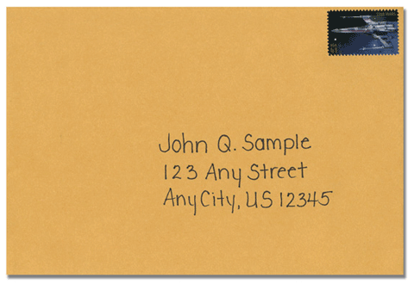
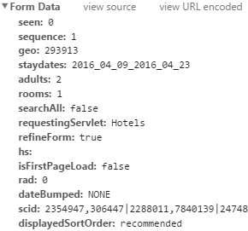
什麼是POST?
POST
內容寫在信紙，包在信封內
https://www.tripadvisor.com.tw/Hotels

Slide 19
使用requests.post 取得旅館資訊
import requests
payload = {
‘seen’:‘0’, ‘sequence’:‘1’, 'geo':'293913',
'staydates':'2016_04_09_2016_04_23',
‘adults’:‘2’, ‘rooms’:‘1’, 'searchAll':'false',
'requestingServlet':'Hotels',
‘refineForm’:‘true’, 'isFirstPageLoad':'false',
‘rad’:‘0’, 'dateBumped':'NONE',
‘scid’:‘2354947,306447|2288011,7840139|2474845,1411424|2492762,1797213|1887821,1372927’, 'displayedSortOrder':'recommended'
}
res = requests.post('https://www.tripadvisor.com.tw/Hotels', data=payload)
print res.text

Slide 20

GET V.S. POST
GET
內容寫在上頭
POST
內容寫在信紙，包在信封內

Slide 21
資料剖析

Slide 22
DOM Tree
html
<html>
<body>
<h1 id="title">Hello World</h1>
<a href="#" class="link">This is link1</a>
<a href="# link2" class="link">This is link2</a>
</body>
</html>
body
h1
a
a
Document Object Model

Slide 23
使用BeautifulSoup4
可以用來剖析及萃取 HTML的內容
會自動將讀入的內容轉換成UTF-8編碼
底層使用lxml及html5lib，可以使用不同的剖析函式以取得速度與彈性的平衡
BeautifulSoup(html_sample, 'html.parser')
可抽換Parser

Slide 24
BeautifulSoup 範例
將網頁讀進BeautifulSoup 中
from bs4 import BeautifulSoup
html_sample = '''
<html>
<body>
<h1 id="title">Hello World</h1>
<a href="#" class="link">This is link1</a>
<a href="# link2" class="link">This is link2</a>
</body>
</html>'''
soup = BeautifulSoup(html_sample, 'html.parser')
print soup.text

Slide 25
找出所有含a tag 的HTML 元素
使用Select 找出(第一個)含有a tag 的元素
soup = BeautifulSoup(html_sample, 'html.parser')
alink = soup.select('a')
print alink

Slide 26
取得含有特定ID的元素
使用Select 找出所有id為title的元素
alink = soup.select('#title')
print alink
ID 前面必須加上 #

Slide 27
取得含有特定class的元素
使用Select 找出所有class為link的元素
soup = BeautifulSoup(html_sample, 'html.parser')
for link in soup.select('.link'):
print link
Class 前面必須加上 .

Slide 28
取得所有a tag 內的連結
使用select找出所有a tag 的href 連結
alinks = soup.select('a')
for link in alinks:
print link['href']

Slide 29
尋找CSS 的定位
Chrome 開發人員工具
Firefox 開發人員工具
InfoLite
https://chrome.google.com/webstore/detail/infolite/ipjbadabbpedegielkhgpiekdlmfpgal

Slide 30
TripAdvisor 抓取實戰

Slide 31
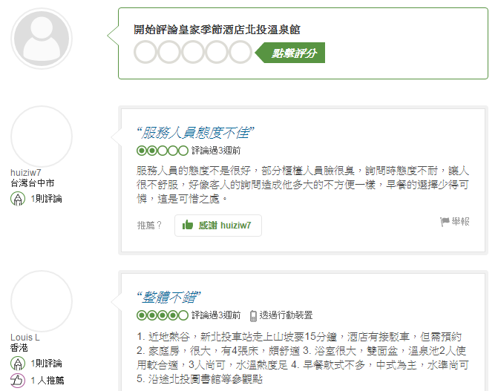
目標：如何抓取TripAdvisor 所有評論

Slide 32
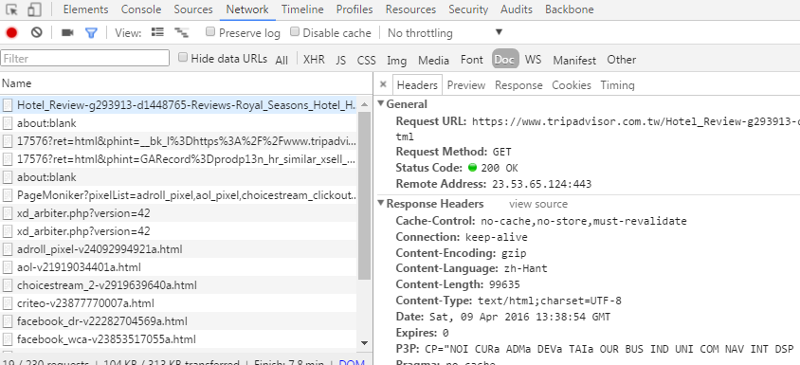
觀察網路Log
1. 點選Network
2. 點選DOC
3. 點選連結

Slide 33
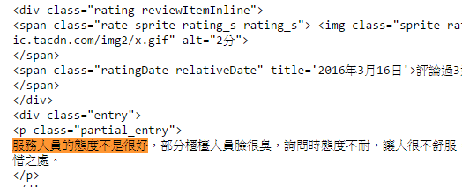
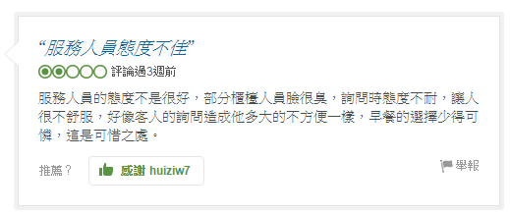
使用GET 抓取評論
import requests
res = requests.get('https://www.tripadvisor.com.tw/Hotel_Review-g293913-d1448765-Reviews-Royal_Seasons_Hotel_Hot_Spring_Beitou-Taipei.html')
print res.text
對照內文是否有相同文字

Slide 34
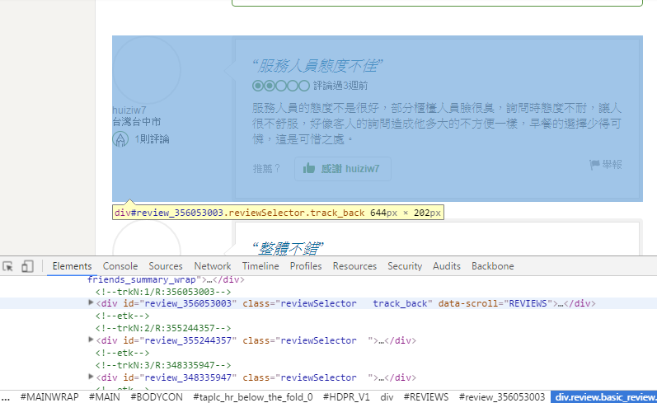
找尋區隔元素
以reviewSelector 作區分

Slide 35
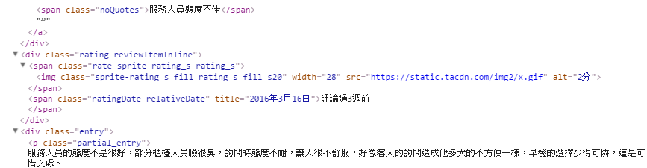
找尋評論資料位置
from bs4 import BeautifulSoup as bs
soup = bs(res.text)
for review in soup.select('.reviewSelector'):
print review.select('.noQuotes'), \
review.select('.rate'), \
review.select('.ratingDate'), \
review.select('.partial_entry')

Slide 36
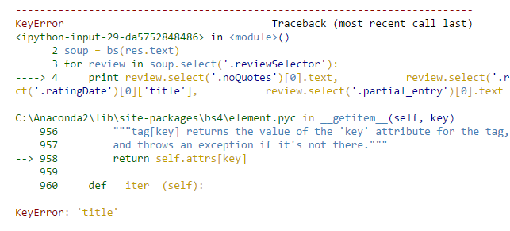
解析內部內容
from bs4 import BeautifulSoup as bs
soup = bs(res.text)
for review in soup.select('.reviewSelector'):
print review.select('.noQuotes')[0].text, \
review.select('.rate > img')[0]['alt'], \
review.select('.ratingDate')[0]['title'], \
review.select('.partial_entry')[0].text
不是每個評論日都有title

Slide 37
使用get 取值
for review in soup.select('.reviewSelector'):
ratingdate = review.select('.ratingDate')[0].get('title', ratingdate_tmp.text)
字典範例
dic = {'a':100, 'b':"yes", 'c':0.98}
print dic['a']
print dic.get('a')
print dic['d']
print dic.get('d', ‘default')
如果title 不存在
改取文字部分
如果key不存在
改取default 值

Slide 38
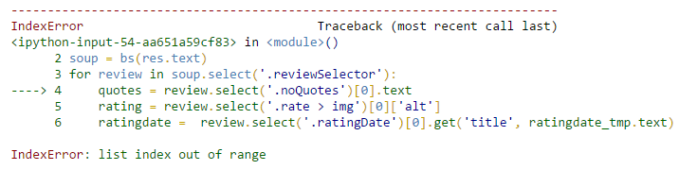
部分評論找不到noQuotes
from bs4 import BeautifulSoup as bs
soup = bs(res.text)
for review in soup.select('.reviewSelector'):
quotes = review.select('.noQuotes')[0].text
rating = review.select('.rate > img')[0]['alt']
ratingdate = review.select('.ratingDate')[0].get('title', ratingdate_tmp.text)
comment =review.select('.partial_entry')[0].text

Slide 39
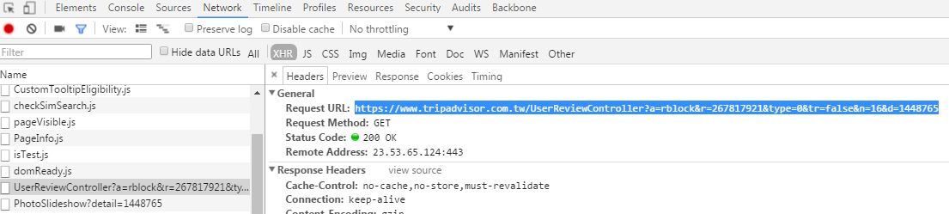
發現部分評論是在xhr
1. 點選Network
2. 點選Xhr
3. 點選連結
https://www.tripadvisor.com.tw/UserReviewController?a=rblock&r=267817921&type=0&tr=false&n=16&d=1448765

Slide 40
增加檢查機制
from bs4 import BeautifulSoup as bs
soup = bs(res.text)
for review in soup.select('.reviewSelector'):
if len(review.select('.noQuotes')) >0:
quotes = review.select('.noQuotes')[0].text
rating = review.select('.rate > img')[0]['alt']
ratingdate = review.select('.ratingDate')[0].get('title', ratingdate_tmp.text)
comment =review.select('.partial_entry')[0].text
檢查是否有noQuotes

Slide 41
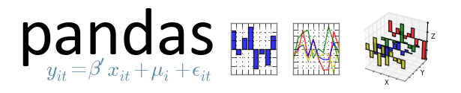
使用Pandas整理資料
Python for Data Analysis
提供高效能、簡易使用的資料格式(Data Frame)讓使用者可以快速操作及分析資料

Slide 42
使用Pandas整理資料
開一個空的list
review_list = []
for review in soup.select('.reviewSelector'):
if len(review.select('.noQuotes')) >0:
quotes = review.select('.noQuotes')[0].text
rating = review.select('.rate > img')[0]['alt']
ratingdate = review.select('.ratingDate')[0].get('title', ratingdate_tmp.text)
comment =review.select('.partial_entry')[0].text
review_list.append({'quotes': quotes, 'rating':rating, 'ratindate':ratingdate, 'comment':comment})
使用list 存放評論

Slide 43
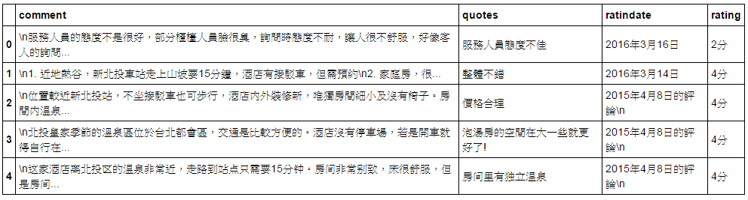
使用DataFrame
import pandas as pd
df = pd.DataFrame(review_list)
df.head()
使用head 看前五列

Slide 44
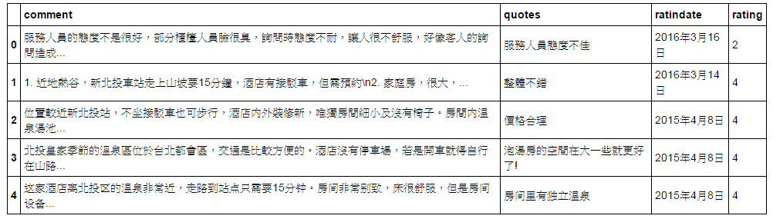
使用pandas清理資料
df['rating'] =df['rating'].map(lambda x: x.rstrip('分'.decode('utf-8')))
df['ratindate'] =df['ratindate'].map(lambda x: x.strip().rstrip('的評論'.decode('utf-8')).encode('utf-8') )
df['comment'] =df['comment'].map(lambda x: x.strip())
df.head()

Slide 45
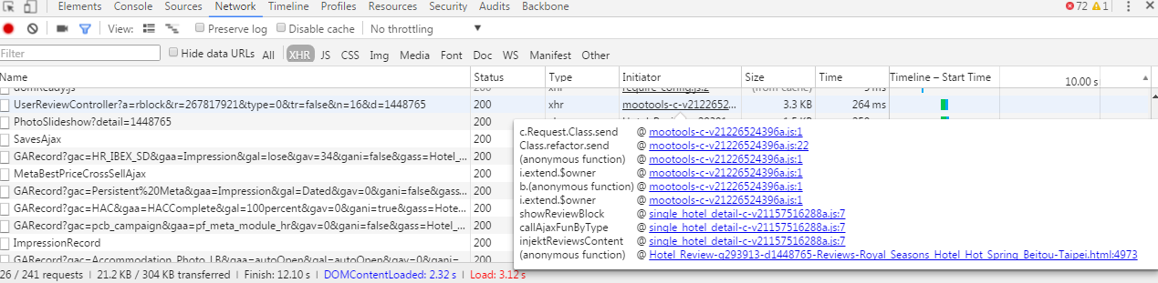
補完其餘評論
找到進入點

Slide 46
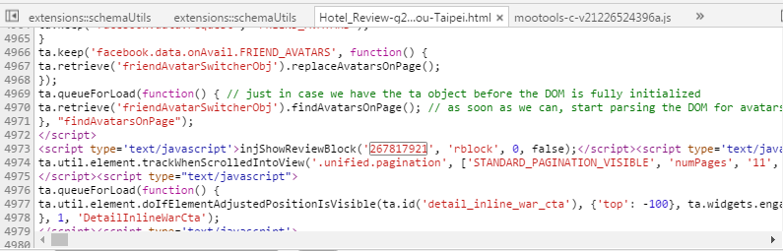
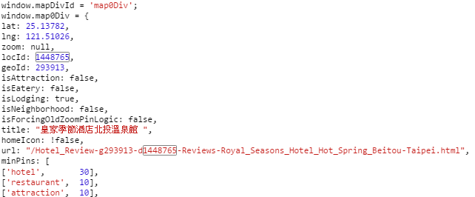
有包含Review ID 跟locid資訊
injShowReviewBlock('267817921', 'rblock', 0, false);
locId: 1448765,

Slide 47
正規表達式 (符號與意義)
符號 | 意義
. | 比對除換行外的任意字元
^ | 比對字串開始
$ | 比對字串結尾
* | 比對0個或多個由前面正規表達式定義的片段，貪婪方式
+ | 比對1個或多個由前面的正規表達式定義的片段，貪婪方式
? | 比對0個或1個由前面的正則表達式定義的片段，貪婪方式
*? , +?, ?? | 非貪婪版本的 *, +, 和 ? (盡可能少的比對)
[...] | 比對方括號內內的字元集中的任意一個字元
(...) | 比對括號內的表達式，也表示一個群組
(?P<id>...) | 類似 (...), 但該組同時得到一個 id,可以在後面的模式中引用

Slide 48
正規表達式範例
正規表達式
import re
m = re.match(r"(\w+)@(\w+)", "david@numerinfo.com")
print m.groups()
m = re.match(r"(\w+)@([a-z.]+)", "david@numerinfo.com")
print m.groups()
m = re.match(r"(\d+)\.(\d+)", "1999.5")
print m.groups()
m = re.match(r"(?P<first_name>\w+) (?P<last_name>\w+)", "David Chiu")
print m.group('first_name'), m.group('last_name')
str1 = 'scp file.txt root@10.0.0.1:./'
m=re.search('^scp ([\w\.]+) (\w+)@([\w\.]+):(.+)',str1)
if m:
print m.group(1), m.group(2), m.group(3), m.group(4)

Slide 49
找到review id 與 locid
import requests
import re
res = requests.get('https://www.tripadvisor.com.tw/Hotel_Review-g293913-d1448765-Reviews-Royal_Seasons_Hotel_Hot_Spring_Beitou-Taipei.html')
m = re.search('injShowReviewBlock\(\'(\d+)\', \'rblock\', 0, false\);', res.text)
reviewid = m.group(1)
m = re.search('locId: (\d+),', res.text)
locid = m.group(1)
print reviewid, locid

Slide 50
抓取非同步評論
reviewurl = 'https://www.tripadvisor.com.tw/UserReviewController?a=rblock&r={}&type=0&tr=false&d={}'
res = requests.get(reviewurl.format(reviewid, locid))
print res.text

Slide 51
使用format 建立使用者評論URL
reviewurl = 'https://www.tripadvisor.com.tw/UserReviewController?a=rblock&r={}&type=0&tr=false&d={}'
res = requests.get(reviewurl.format(reviewid, locid))
soup = bs(res.text)
for review in soup.select('.reviewSelector'):
quotes = review.select('.noQuotes')[0].text
rating = review.select('.rate > img')[0]['alt']
ratingdate = review.select('.ratingDate')[0].get('title', ratingdate_tmp.text)
comment =review.select('.partial_entry')[0].text
print quotes, rating, ratingdate, comment

Slide 52
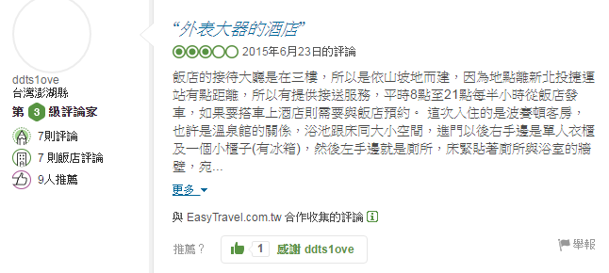
點選更多展開文章
點選更多

Slide 53
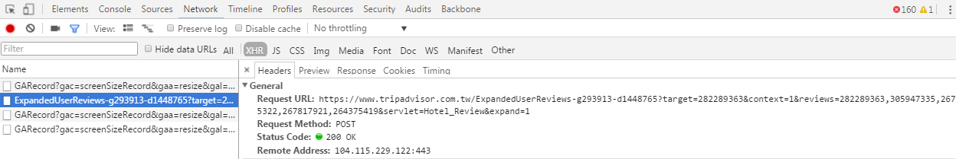
“更多” 可以展開評論
ExpandedUserReviews 的reviews後面接文章的review ID
https://www.tripadvisor.com.tw/ExpandedUserReviews-g293913-d1448765?target=282289363&context=1&reviews=282289363,305947335,267945322,267817921,264375419&servlet=Hotel_Review&expand=1

Slide 54
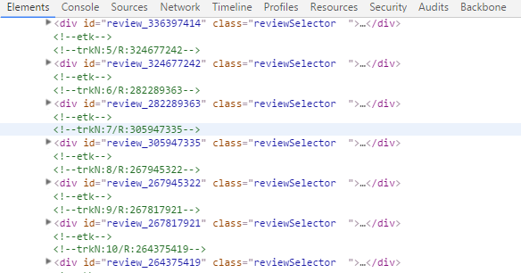
整理出review ID
import requests
import re
res = requests.get('https://www.tripadvisor.com.tw/Hotel_Review-g293913-d1448765-Reviews-Royal_Seasons_Hotel_Hot_Spring_Beitou-Taipei.html')
soup = bs(res.text)
for review in soup.select('.reviewSelector'):
print review['id']
如何去掉reviews_

Slide 55
如何移除掉字串左右的特定字元?
strip
strip()
rstrip()
lstrip()
Strip 範例
s = " \t string test \t \n\n\r" ' \t string test \t \n\n\r'
print s
print s.strip()
print s.rstrip()
print s.lstrip()

Slide 56

拿掉review
for review in soup.select('.reviewSelector'):
print review['id'].lstrip('review_')
如何將review ID 串聯起來

Slide 57
join
將陣列單元依分隔符號合成字串
a = '123,555,111,99'
ary = a.split(',')
print '|'.join(ary)

Slide 58
將review ID 串聯起來
ary = []
for review in soup.select('.reviewSelector'):
ary.append( review['id'].lstrip('review_'))
','.join(ary)

Slide 59
使用Expand 取得所有資訊
url = 'https://www.tripadvisor.com.tw/ExpandedUserReviews-g293913-d1448765?target={}&context=1&reviews={}&servlet=Hotel_Review&expand=1'
review_list = ','.join(ary)
res = requests.get(url.format(review_list.split(',')[0], review_list))
print res.text
Target 隨便填一個id 即可

Slide 60
展開的資料在extended 下
soup = bs(res.text)
for review in soup.select('.extended'):
quotes = review.select('.noQuotes')[0].text
rating = review.select('.rate > img')[0]['alt']
ratingdate = review.select('.ratingDate')[0].get('title', ratingdate_tmp.text)
comment =review.select('.entry')[0].text
print quotes, rating, ratingdate, comment

Slide 61
將資料整理到list 中
review_list = []
for review in soup.select('.extended'):
quotes = review.select('.noQuotes')[0].text
rating = review.select('.rate > img')[0]['alt']
ratingdate = review.select('.ratingDate')[0].get('title', ratingdate_tmp.text)
comment =review.select('.entry')[0].text
review_list.append({'quotes': quotes, 'rating':rating, 'ratindate':ratingdate, 'comment':comment})

Slide 62
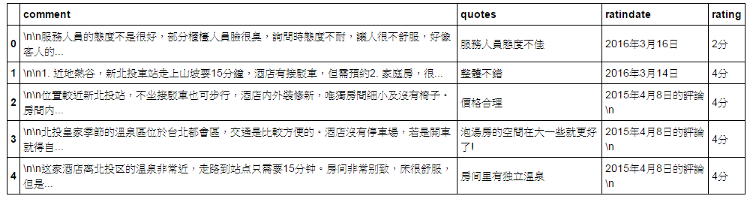
再次使用pandas 整理資料
import pandas as pd
df = pd.DataFrame(review_list)
df.head()

Slide 63
抓取多頁資料

Slide 64
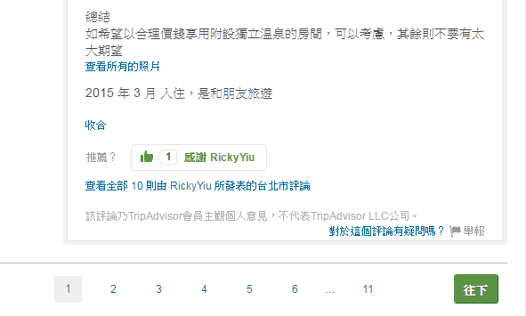
目標：如何抓取多頁評論
抓取所有頁數資料

Slide 65
比較一下連結
https://www.tripadvisor.com.tw/Hotel_Review-g293913-d1448765-Reviews-Royal_Seasons_Hotel_Hot_Spring_Beitou-Taipei.html#REVIEWS
https://www.tripadvisor.com.tw/Hotel_Review-g293913-d1448765-Reviews-or10-Royal_Seasons_Hotel_Hot_Spring_Beitou-Taipei.html#REVIEWS
https://www.tripadvisor.com.tw/Hotel_Review-g293913-d1448765-Reviews-or20-Royal_Seasons_Hotel_Hot_Spring_Beitou-Taipei.html#REVIEWS
每一頁差10
但怎麼知道有幾頁?

Slide 66
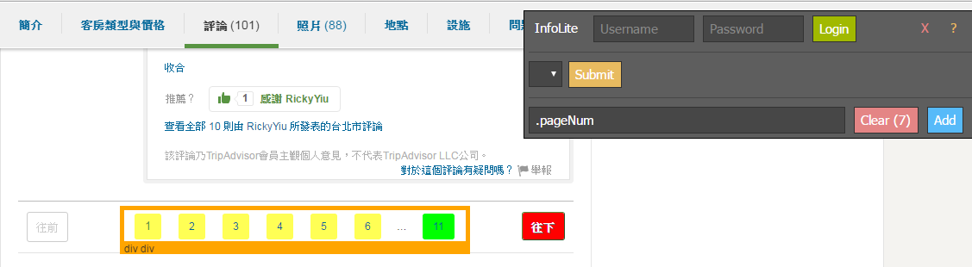
但如何取得頁數
.pageNum 最後一個數字

Slide 67
抓取最後一個數字
import requests
res = requests.get('https://www.tripadvisor.com.tw/Hotel_Review-g293913-d1448765-Reviews-Royal_Seasons_Hotel_Hot_Spring_Beitou-Taipei.html')
soup = bs(res.text)
pagenum = int(soup.select('.pageNum')[-1].text)
print pagenum

Slide 68
產生頁面連結
pageurl = 'https://www.tripadvisor.com.tw/Hotel_Review-g293913-d1448765-Reviews-or{}-Royal_Seasons_Hotel_Hot_Spring_Beitou-Taipei.html#REVIEWS'
for i in range(1,pagenum):
print pageurl.format(str(i * 10 ))

Slide 69
整理抓取頁面函式
def getPageReview(url):
hotelinfo = []
ary = []
res = requests.get(url)
soup = bs(res.text)
for review in soup.select('.reviewSelector'):
ary.append( review['id'].lstrip('review_'))
expandurl = 'https://www.tripadvisor.com.tw/ExpandedUserReviews-g293913-d1448765?target={}&context=1&reviews={}&servlet=Hotel_Review&expand=1'
review_list = ','.join(ary)
res2 = requests.get(expandurl.format(review_list.split(',')[0], review_list))
soup2 = bs(res2.text)
for review in soup2.select('.extended'):
quotes = review.select('.noQuotes')[0].text
rating = review.select('.rate > img')[0]['alt']
ratingdate = review.select('.ratingDate')[0].get('title', ratingdate_tmp.text)
comment =review.select('.entry')[0].text
hotelinfo.append({'quotes': quotes, 'rating':rating, 'ratindate':ratingdate, 'comment':comment})
return hotelinfo

Slide 70
測試函式
url = 'https://www.tripadvisor.com.tw/Hotel_Review-g293913-d1448765-Reviews-Royal_Seasons_Hotel_Hot_Spring_Beitou-Taipei.html'
rev1 = getPageReview(url)
df = pd.DataFrame(rev1)
df

Slide 71
抓取多頁的評論
url = 'https://www.tripadvisor.com.tw/Hotel_Review-g293913-d1448765-Reviews-Royal_Seasons_Hotel_Hot_Spring_Beitou-Taipei.html'
pageurl = 'https://www.tripadvisor.com.tw/Hotel_Review-g293913-d1448765-Reviews-or{}-Royal_Seasons_Hotel_Hot_Spring_Beitou-Taipei.html#REVIEWS'
soup = bs(res.text)
pagenum = int(soup.select('.pageNum')[-1].text)
url_list = [url]
for i in range(1,pagenum):
url_list.append(pageurl.format(str(i * 10 )))
print url_list

Slide 72
將所有的Data Frame 整理成一個list
dfall = []
for url in url_list:
df= pd.DataFrame(getPageReview(url))
dfall.append(df)

Slide 73

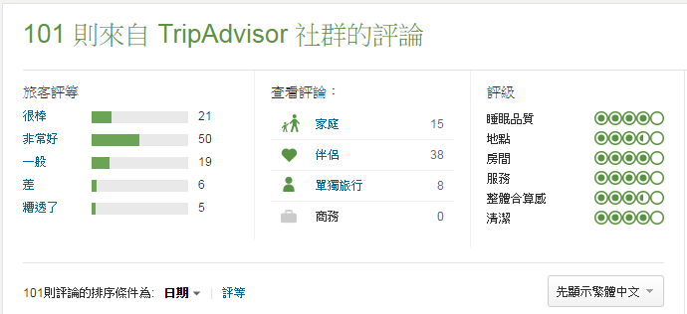
使用concat 合併DataFrame資料
hoteldf = pd.concat(dfall)
hoteldf.head()
hoteldf.count()
抓取101則評論

Slide 74
資料儲存 (SQLITE)

Slide 75
SQLite Manager
安裝SQLite Manager
打開Firefox 後至下列網址 https://addons.mozilla.org/en-US/firefox/addon/sqlite-manager/ 下載適合自己作業系統的版本安裝

Slide 76
課前知識
特性
self-contained
serverless
zero-configuration
Transactional
ACID 資料庫
支援 SQL 92 語法
開源

Slide 77
使用python 連結SQLite
import sqlite3 as lite
import sys
con = None
try:
con = lite.connect(dbname) # connect to database
cur = con.cursor() # create cursor
cur.execute(‘SELECT SQLITE_VERSION()’) # selece database version
data = cur.fetchone() # fetch one data at a time
print "SQLite version: %s" % data
except lite.Error, e:
print "Error %s:" % e.args[0] sys.exit(1)
finally:
if con:
con.close()

Slide 78
使用python 連結SQLite (2)
with con:
cur = con.cursor()
# Read Meta Information
cur.execute("PRAGMA table_info(PhoneAddress)")
rows = cur.fetchall()
for row in rows:
print row

Slide 79
透過SQLite 做資料新增、查詢
import sqlite3 as lite
import sys
con = lite.connect("test.db")
with con:
cur = con.cursor() # Drop Table If Exisits
cur.execute("DROP TABLE IF EXISTS PhoneAddress")
cur.execute("CREATE TABLE PhoneAddress(phone CHAR(10) PRIMARY KEY, address TEXT, name TEXT unique, age INT NOT NULL)")
cur.execute("INSERT INTO PhoneAddress VALUES('0912173381','United State','Jhon Doe',53)")
cur.execute("INSERT INTO PhoneAddress VALUES('0928375018','Tokyo Japan','MuMu Cat',6)")
cur.execute("INSERT INTO PhoneAddress VALUES('0957209108','Taipei','Richard',29)")
cur.execute("SELECT phone,address FROM PhoneAddress")
data = cur.fetchall()
for rec in data:
print rec[0], rec[1]
con.close()

Slide 80
fetchone v.s. fetchall
rows = cur.fetchall()
for row in rows:
print row
data = cur.fetchone()
print data[0], data[1]

Slide 81
使用Pandas 將資料塞進資料庫
import sqlite3 as lite
with lite.connect('tripadvisor.sqlite') as db:
hoteldf.to_sql(name='comments', index=False, con=db, if_exists='replace')

Slide 82
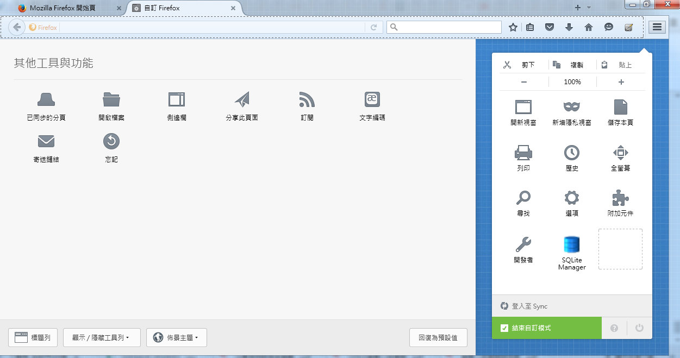
開啟SQLite Manager
開啟SQLite Manager

Slide 83
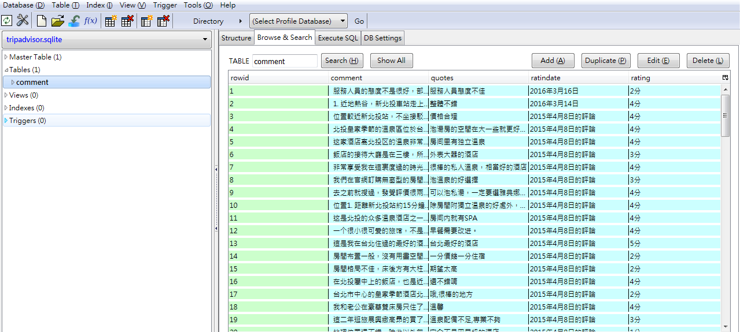
使用SQLite Manager瀏覽資料
檢視所有塞入的資料

Slide 84
使用Pandas 下SQL 查詢資料
import sqlite3 as lite
with lite.connect('tripadvisor.sqlite') as db:
df = pd.read_sql_query('SELECT count(1) FROM comment;', db)
df

Slide 85
AJAX 資料抓取

Slide 86
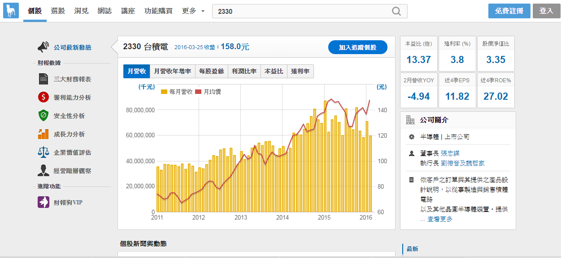
抓取財報狗的資訊
https://statementdog.com/analysis/tpe#2330

Slide 87
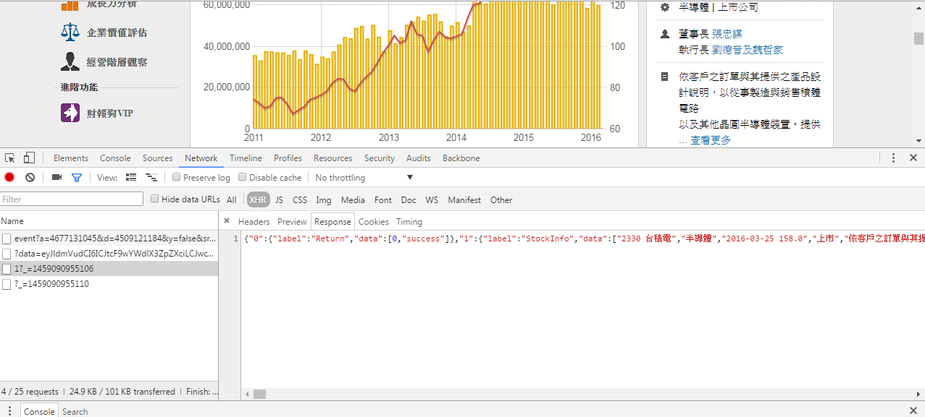
找出呼叫資料的進入點
1. 點選Network
2. 點選XHR
3. 點選連結

Slide 88
抓取圖表資料
import requests
headers = {
'X-Requested-With':'XMLHttpRequest',
'User-Agent':'Mozilla/5.0 (Windows NT 6.1; WOW64) AppleWebKit/537.36 (KHTML, like Gecko) Chrome/49.0.2623.87 Safari/537.36',
}
rs = requests.session()
res = rs.get('https://statementdog.com/analysis/analysis_ajax/2330/2011/1/2016/4/1', headers = headers)
json = res.text

Slide 89
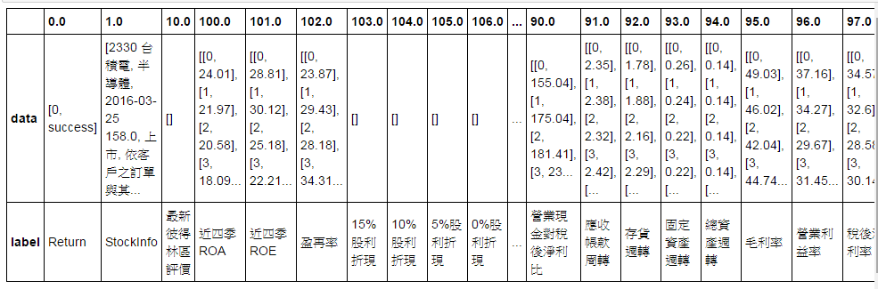
使用Pandas讀取JSON
jdf = pd.read_json(json)
jdf

Slide 90
使用Selenium 抓資料

Slide 91
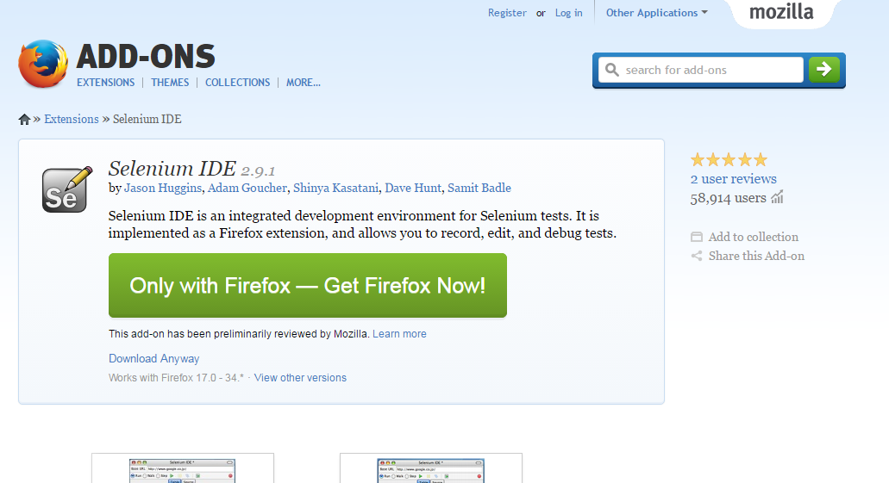
使用Selenium Plugin
https://addons.mozilla.org/en-US/firefox/addon/selenium-ide/

Slide 92
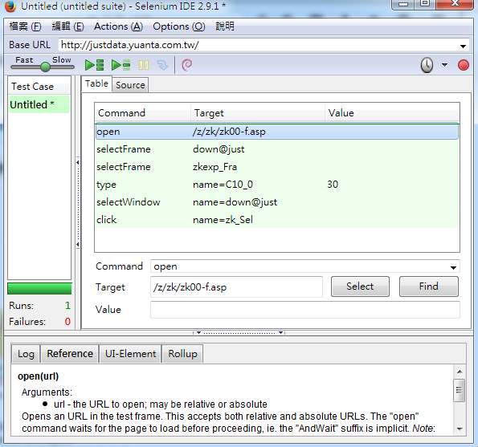
使用Selenium Plugin 錄製動作

Slide 93
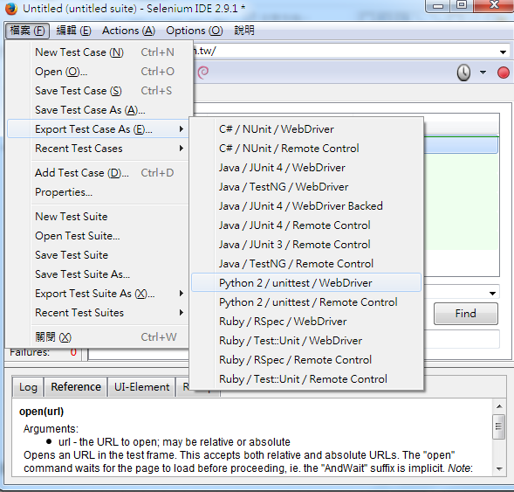
匯出Selenium 腳本

Slide 94
執行Selenium 腳本
# -*- coding: utf-8 -*-
from selenium import webdriver
from selenium.webdriver.common.by import By
from selenium.webdriver.common.keys import Keys
from selenium.webdriver.support.ui import Select
from selenium.common.exceptions import NoSuchElementException
from selenium.common.exceptions import NoAlertPresentException
from bs4 import BeautifulSoup
import unittest, time, re
driver = webdriver.Firefox()
driver.implicitly_wait(30)
driver.get("http://justdata.yuanta.com.tw/z/zk/zk00-f.asp")
soup = BeautifulSoup(driver.page_source)
print soup
driver.close()
需要執行pip install selenium

